Slide 1



Summer Internship Domain – S/W engineer(Ai/Ml Intern)
Praxon Technovation Pvt.Ltd.
Ashutosh 20EJICS019
JIET 4^{th CSE}

Slide 2
Table of content

Slide 3
About Company
Praxon Technovations Private Limited (PTPL) is a Private Limited Indian Non-Government Company incorporated in India on 14 July 2022 ( 11 months old). Its registered office is in Thane, Maharashtra, India.
The Company is engaged in the Information Technology Industry.
Samridhi Vyas, Anand Vyas, Lavanya Vyas, and One other member serve as directors at the Company.
Industry
Information Technology Information Technology Services

Slide 4
About Internship
As we know that Praxon Technovations Private Limited (PTPL) its registered office is in Thane, so they provide internship in virtual mode into different domain like in Web , AI/ML and Cloud and I am chosen for both as web and AI/ML intern.
They taught us about basic Microsoft tools and provide us an training and certification of Microsoft Azure , Microsoft learning path.
The company made up a team as Team Gladiators with 4 person and provide us to 3 to 4 Project with 1 web framework project (Ashutosh Portfolio) which is on Google AppSheet.
The internship duration is 4 month from 17 may 2023 – 17 Sep 2023

Slide 5
About My Role and Work
As web developer in a Praxon Technovation my work is in website design.
I use HTML, CSS, JavaScript and React to build the client side of a website, including the layout, buttons, menus, forms, and other features that users see and interact with when they visit a webpage.
Basically this layout designed by UI/UX developer then according to it I’ll build similar of things with functionality
After Frontend work I’ll need to add on backend(Django/Flask) and Database(MySQL) with it.
I need to perform python automation and web scraping to get data and EDA on given datasets and puts machine learning algorithm on it.

Slide 6
Skills which I learnt during internship
As web developer and Ai/Ml intern in a Praxon Technovation I learnt about
Front End Skills – Html , CSS , BS , JavaScript , jQuery , React
Microsoft Tools – Teams , Outlook , Excel , Power Point , Word , Azure DevOps , Power Bi
Web Frame Work – Google App sheet
Automation – Selenium with Python
Back End Skills – Python Flask , MySQL , SQL
Data Science , ML basics ,Exploretray Data Analysis
Git and Github
Data Structure , DBMS , Computer Network
Aptitude
Microsoft Learning Path – DP-900

Slide 7
What Is Frontend Development?
frontend development involves a combination of design, coding, and problem-solving skills to create visually appealing, responsive, and interactive web interfaces that deliver a seamless user experience.
Frontend development typically involves the use of HTML (Hypertext Markup Language), CSS (Cascading Style Sheets), and JavaScript. Here's a brief overview of each of these technologies:
HTML: HTML provides the structure and content of a web page.
CSS: CSS is used to control the presentation and styling of web pages
JavaScript: JavaScript is a programming language that enables dynamic interactivity on web pages. It adds functionality and behavior to the frontend components
In addition to these core technologies, frontend developers often use various libraries, frameworks, and tools to their workflow and enhance productivity. Popular frontend frameworks include React, Angular, and Vue.js, which provide reusable components and efficient ways to manage complex UIs

Slide 8
What Is Backend Development?
Backend development focuses on building the logic and infrastructure that enable the frontend to function smoothly. It involves working with databases, APIs, server-side programming, and ensuring the performance, scalability, and security of the web application.
Collaborating with frontend developers, backend developers create the necessary APIs and endpoints to provide data and functionality to the user interface.
While frontend development focuses on the client-side and user-facing aspects, backend development deals with the behind-the-scenes operations that enable the frontend to function.
Backend developers use programming languages like Python, Java, Ruby, PHP, or Node.js to write the server-side code. These languages allow developers to handle data processing, implement business logic, and communicate with databases and other systems.

Slide 9
Microsoft Tools
1.MS Teams Microsoft Teams is a collaborative platform developed by Microsoft that combines chat, video meetings, file storage, and application integration. It is designed to facilitate communication and collaboration within teams and organizations
2.MS Outlook
Microsoft Outlook is a comprehensive email client and personal information manager that provides a range of features to help users manage their emails, calendars, contacts, and tasks. It is widely used by individuals, businesses, and organizations for efficient communication, organization, and productivity.
3.MS Excel
Excel is widely used in various industries and sectors, including finance, accounting, data analysis, project management, and more. It provides a versatile platform for managing and analyzing data, making complex calculations, and creating visual representations of information.

Slide 10
Microsoft Tools
4.MS Power Point Microsoft PowerPoint is a popular presentation software developed by Microsoft. It is part of the Microsoft Office suite and is widely used for creating and delivering slide-based presentations. PowerPoint offers a range of features and tools to help users design visually appealing and engaging presentations
5.MS Word
Microsoft Word is widely used for creating and editing documents in various fields, including business, education, and personal use. Its user-friendly interface, extensive formatting options, collaboration features, and integration with other Office applications make it a versatile and essential tool for word processing.

Slide 11
Azure DevOps
Python
Python is a high-level, interpreted programming language known for its simplicity, readability, and versatility. It was created by Guido van Rossum and first released in 1991. Python has gained widespread popularity and is widely used in various domains, including web development, data analysis, artificial intelligence, scientific computing, automation, and more.
DevOps practices are widely adopted by organizations to accelerate software development, enhance collaboration, improve quality, and increase the speed of software delivery. It enables teams to build and deploy applications more frequently, reliably, and efficiently, resulting in faster time-to-market and better customer satisfaction.
Google Sites
Google Sites is a web-based tool provided by Google that allows users to create and publish websites without the need for coding or technical expertise. It provides a simple and intuitive interface for building websites, making it accessible to individuals and organizations with varying levels of web development experience

Slide 12
Projects
Python Automation Script for Watsapp Messanger
Create News App with react according different categories
Ecommerce site component for Jamiston Pvt.Ltd.
Create Ashutosh portfolio with Google Appsheet
Create Ashutosh portfolio with React
Rock Paper Scissor Game in Frontend React
EDA on IPL Data
Future Projects
Full stack site on flask
IPL , FIFA , Marvel ,Cricket data Science and ML Project
Responsive Report on PowerBi , Excel for data Analysis

Slide 13
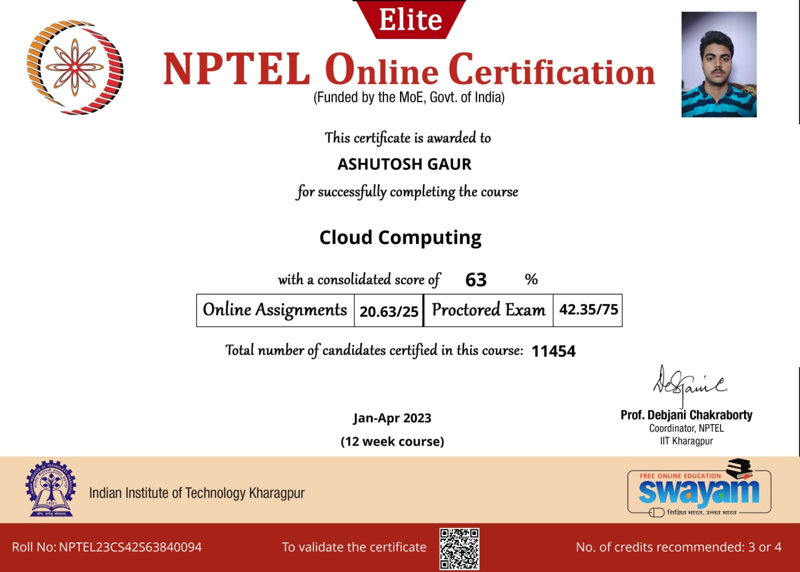
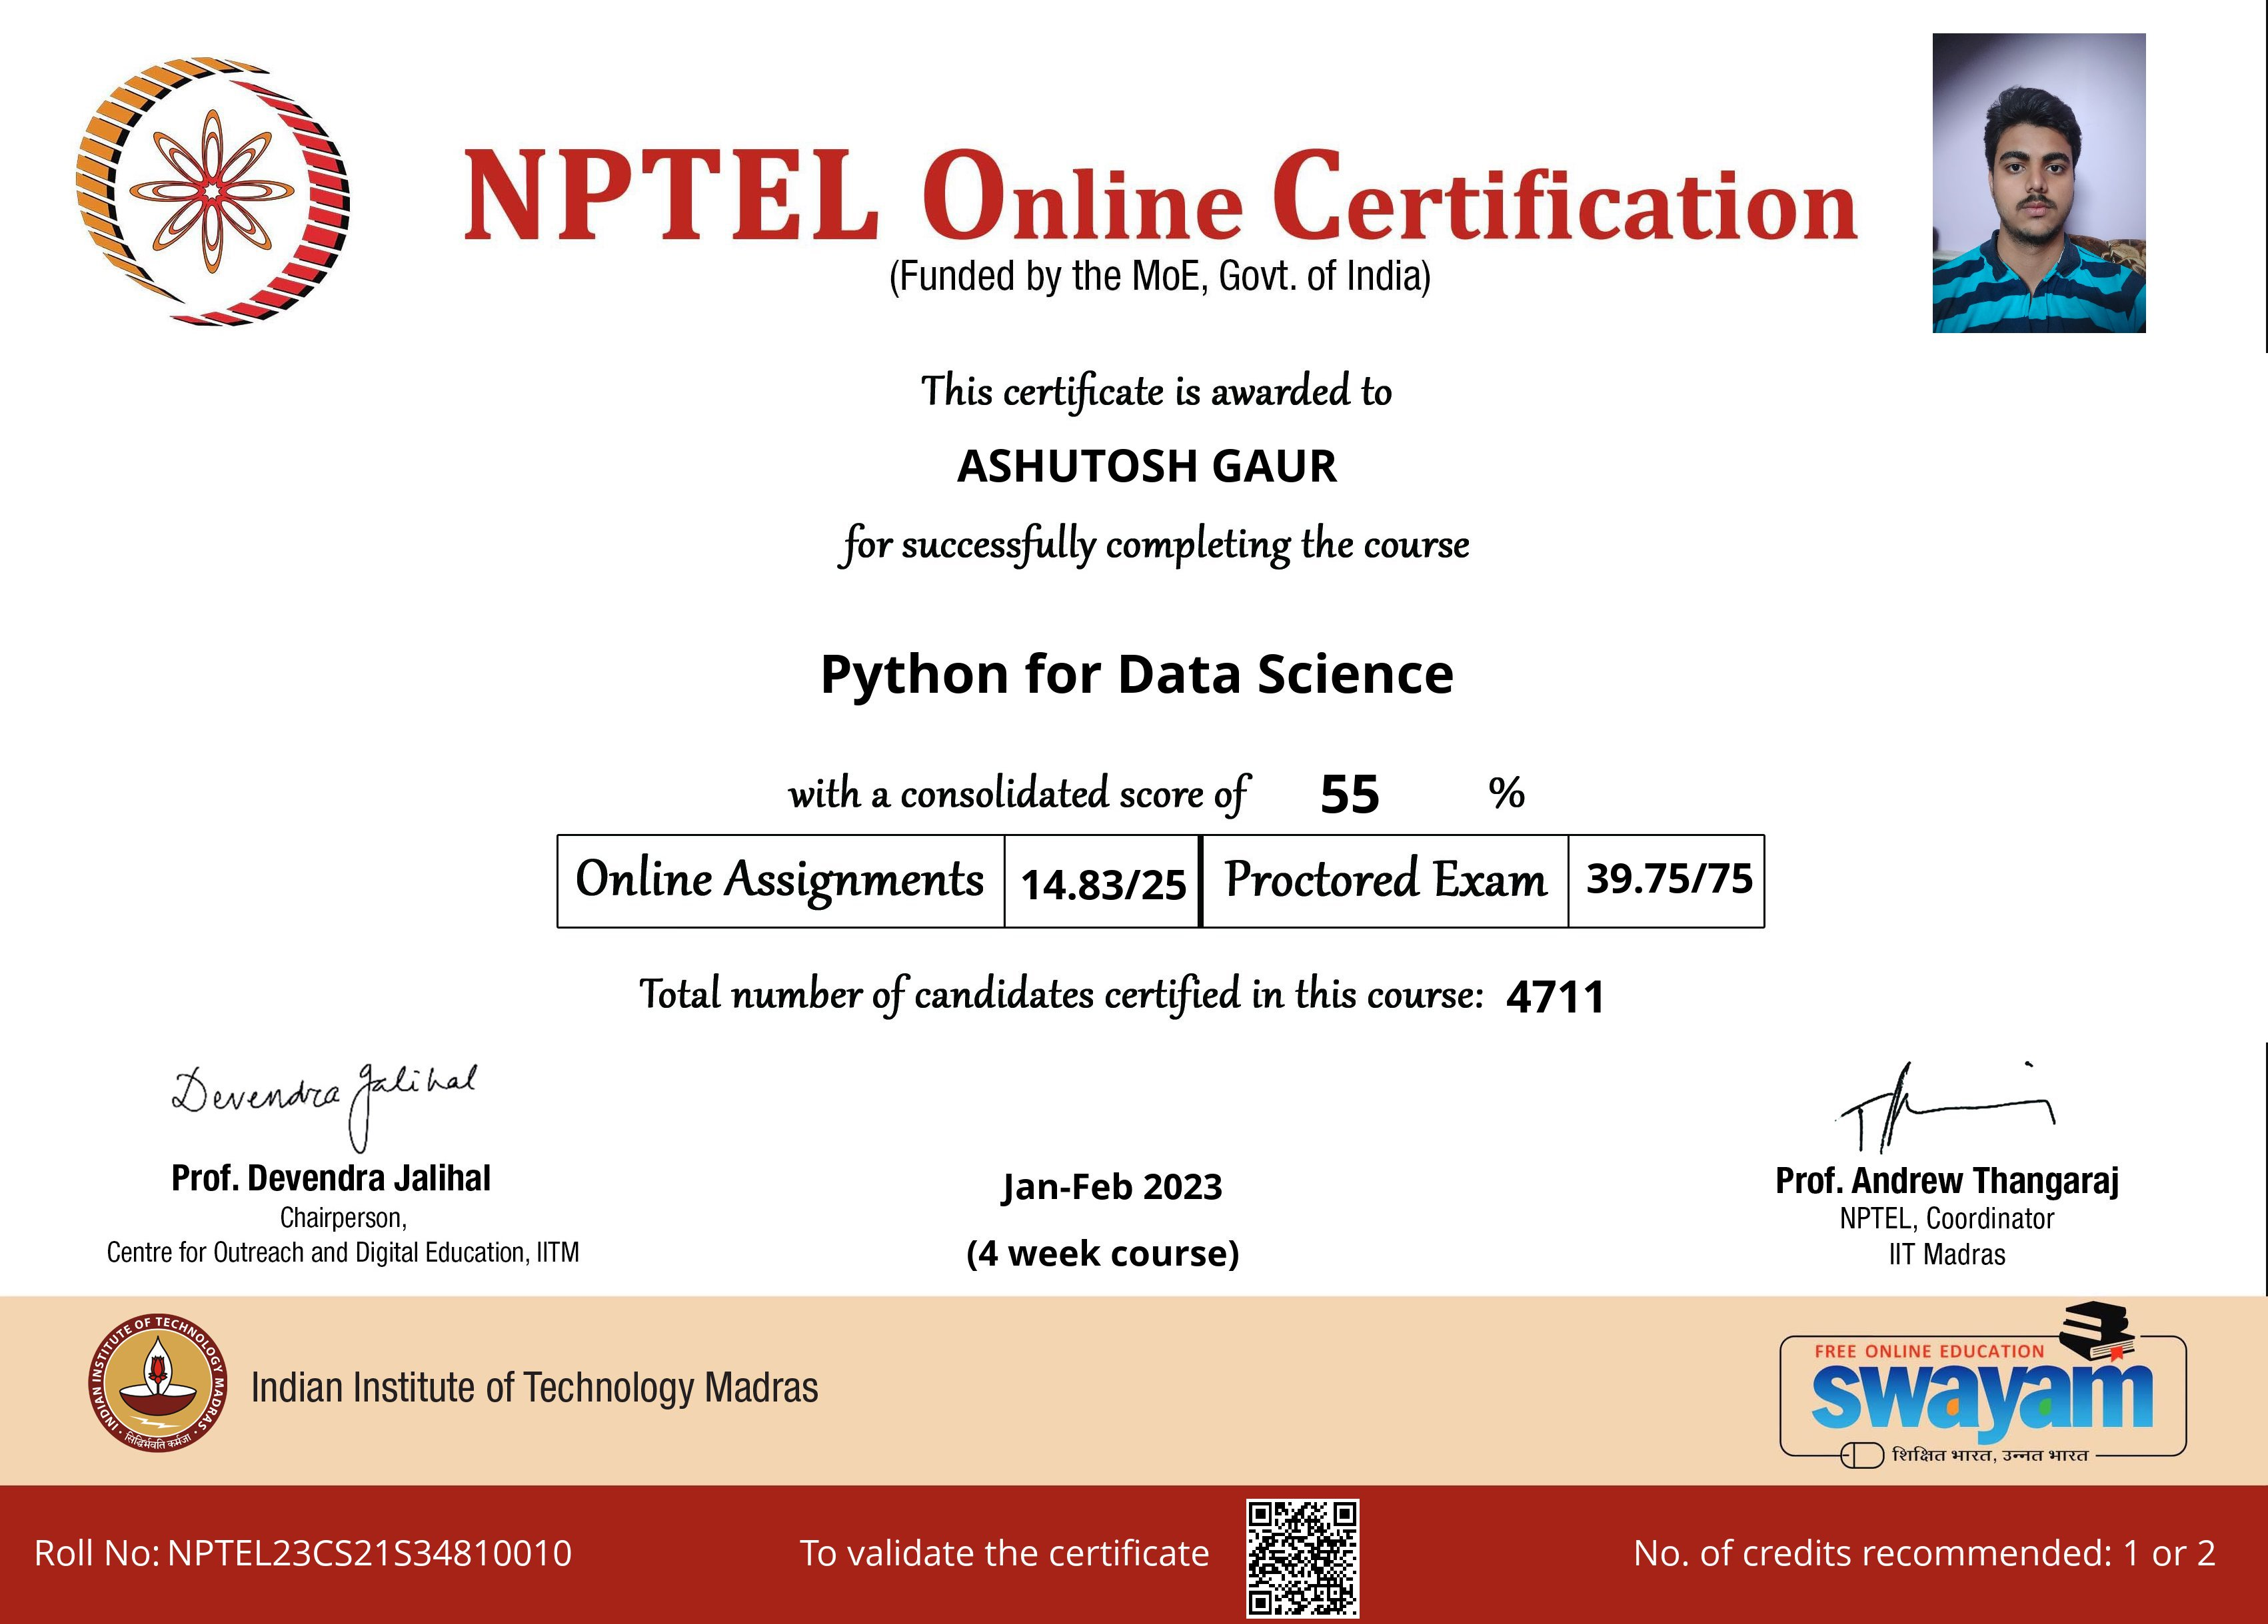


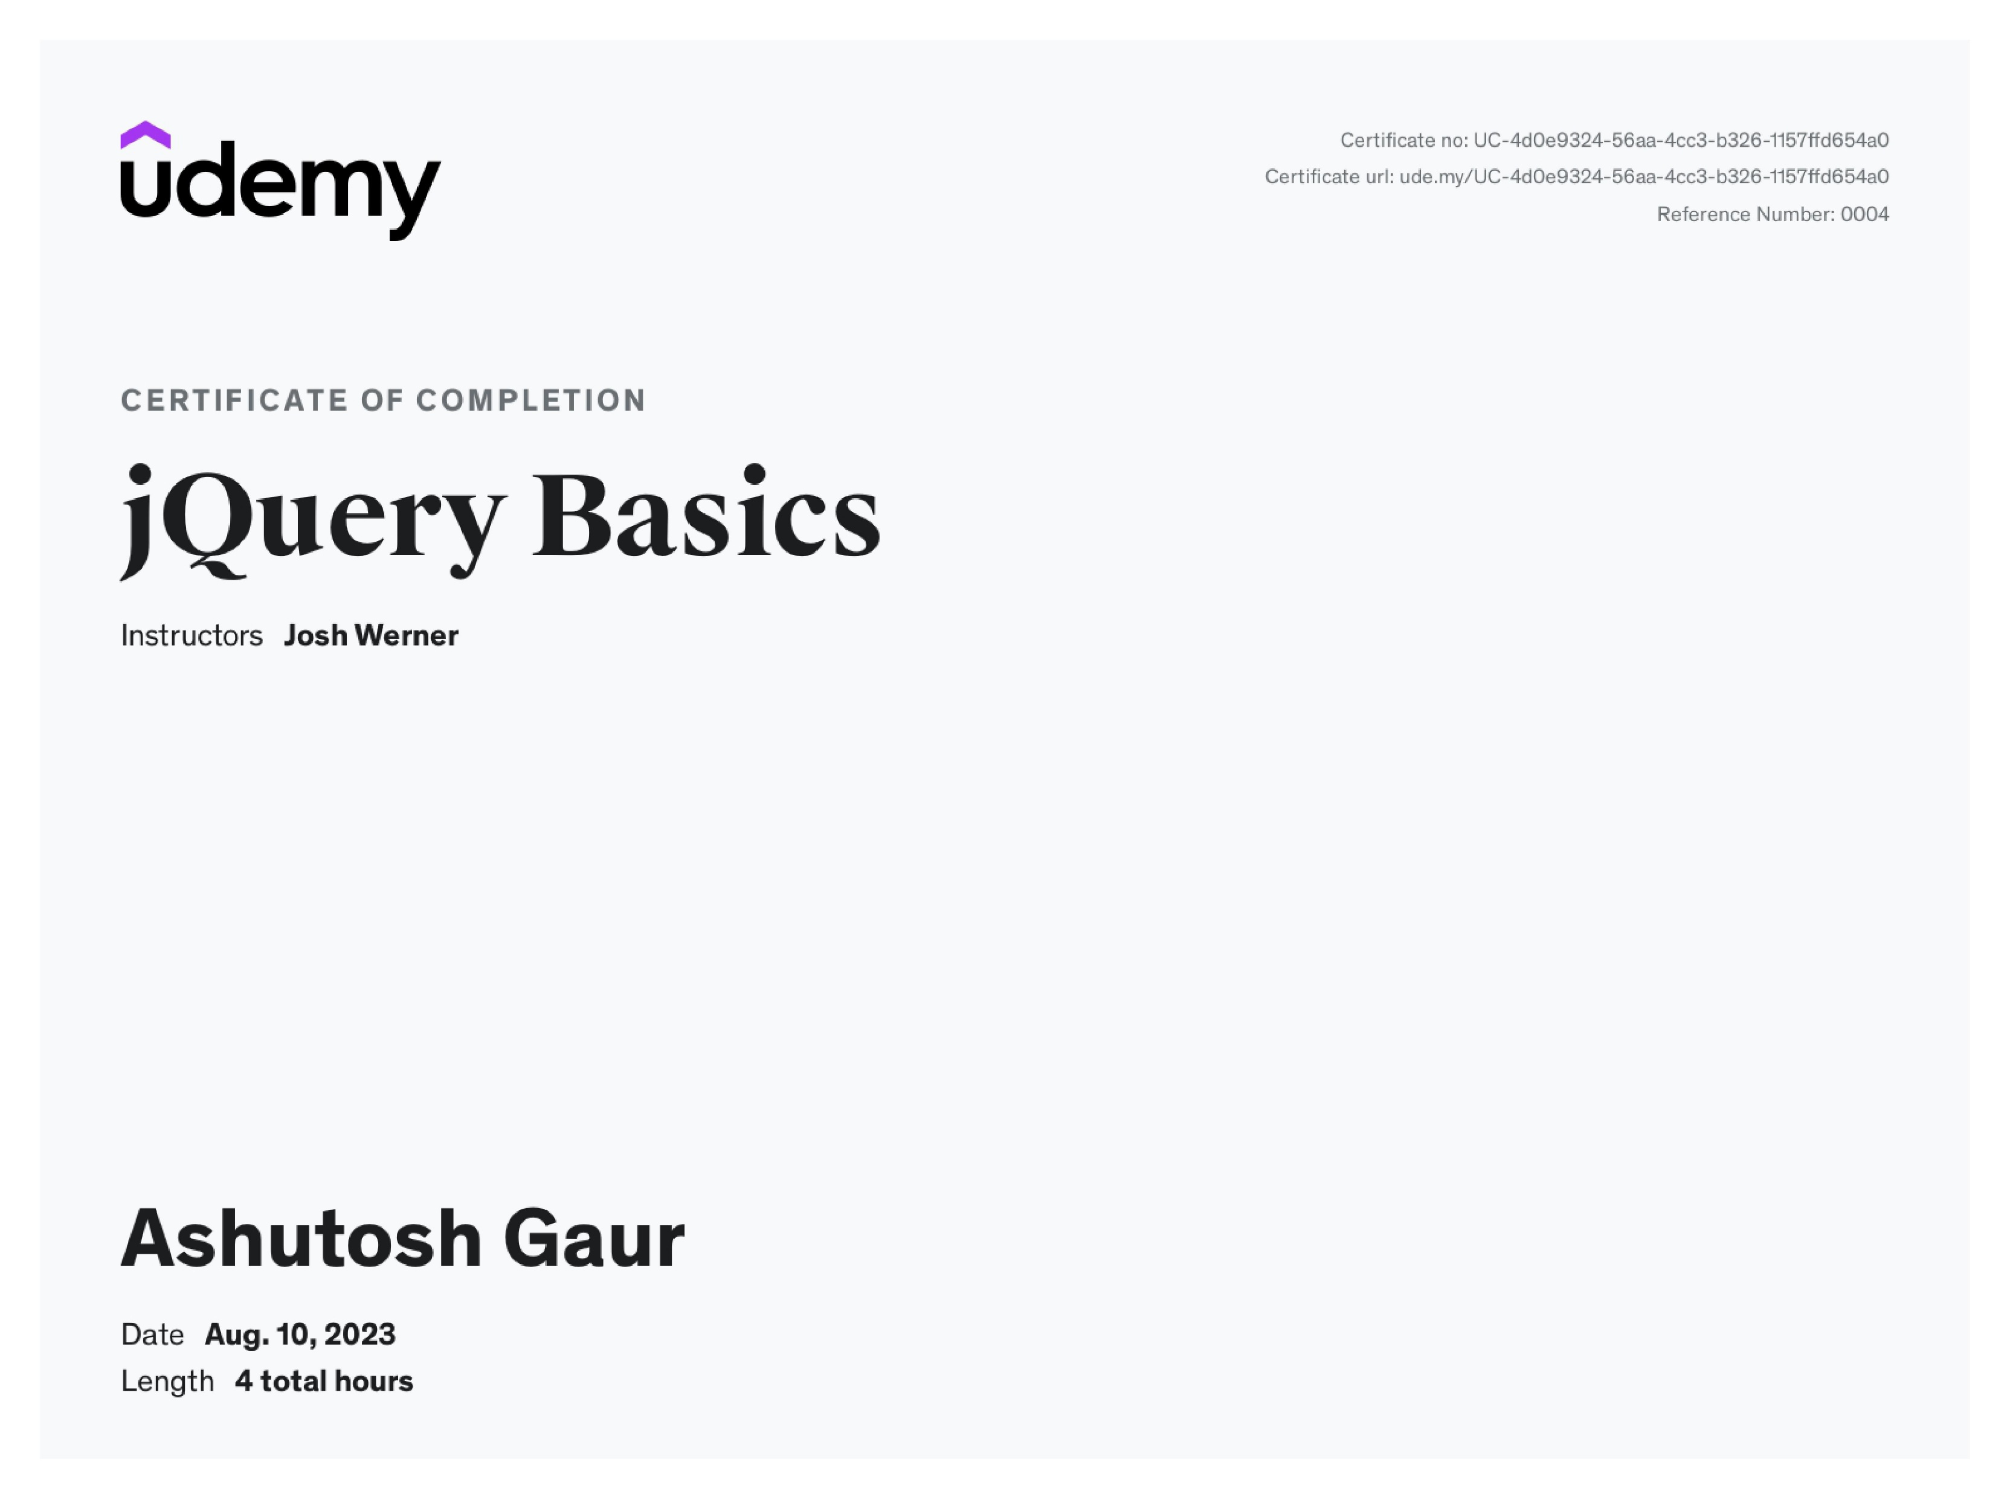

Certification

Slide 14


Slide 15




Thank you
Ashutosh Gaur
ashutoshgaur0809@gmail.com
7014729896

